Slide 1
Analyzing the Global Developer Landscape:
Insights from the Stack Overflow Developer Survey
Prepared by: Walid Barghout
DATE: 15/01/2025
An overview of the current landscape and anticipated future trends within the global developer community, encompassing programming skills, database technologies, platforms, and demographics.

Slide 2



Project Overview
Analyze Stack Overflow Developer Survey Data
Identify Trends in Programming Languages, Databases, and IDEs
Explore Respondent Demographics
The analysis dives into the age, education level, and geographical distribution of the survey participants.
This project explores the global developer community through the lens of the Stack Overflow Developer Survey.
The primary objective is to uncover the latest developments and rising demands in the technology landscape.
By leveraging the insights from this comprehensive analysis, we aim to provide a deeper understanding of the evolving needs and preferences of the global developer community.

Slide 3


Data Collection and Preparation
Data Sources
Data Cleaning and Transformation
The data used in this project is the Stack Overflow Developer Survey dataset, which is a comprehensive survey of developers worldwide. Additional data is scrapped from various sources, such as job postings and training portals.
The collected data is cleaned, transformed, and integrated to prepare it for analysis. This includes handling missing values, removing duplicates, normalizing data types, and merging datasets from different sources.

Slide 4
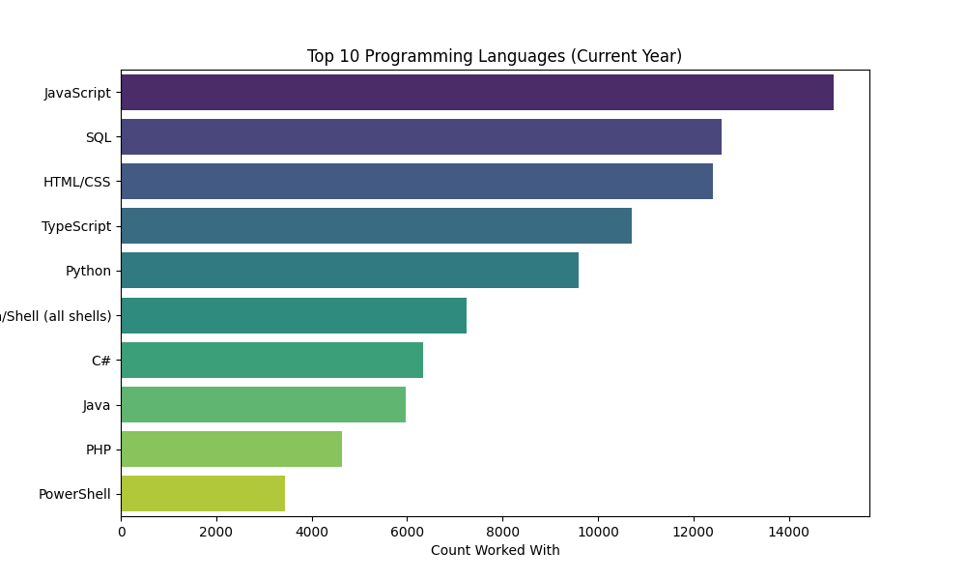
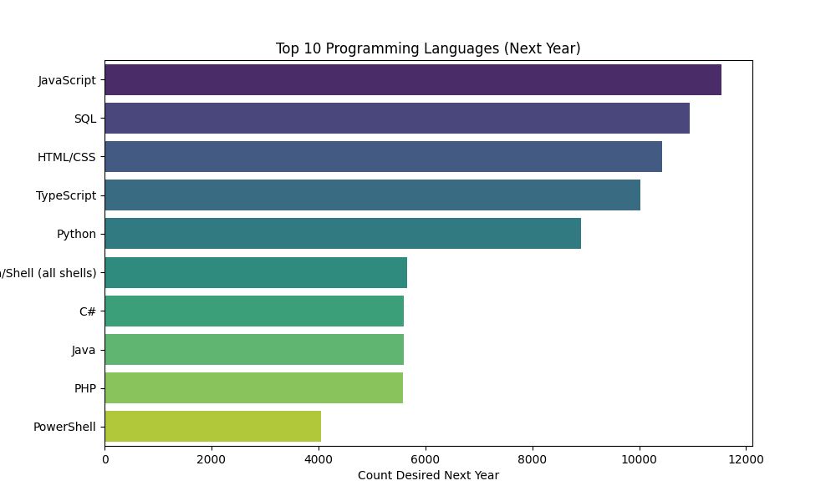

Slide 5
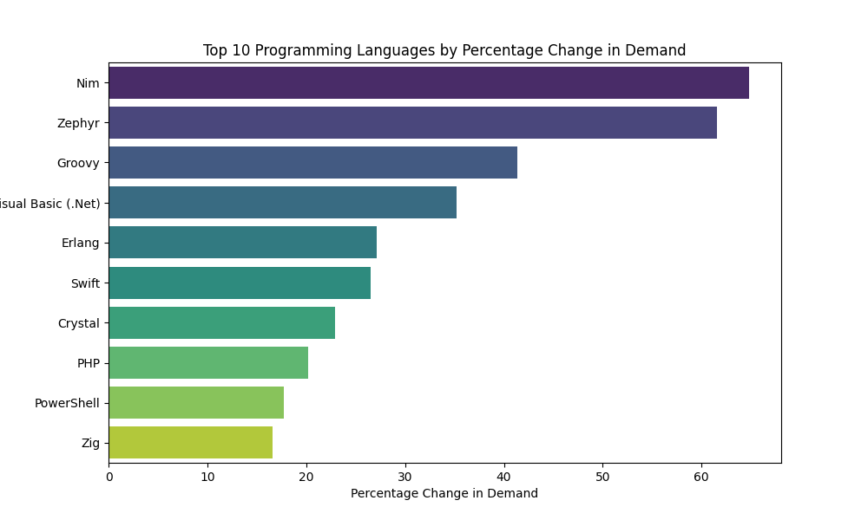
Interpretation of Results
Language: The programming languages listed in order of the highest to the lowest percentage change in demand.
Count Worked With: The number of respondents who have worked with each language.
Count Desired Next Year: The number of respondents who want to work with each language in the next year.
Demand Change: The percentage change in demand for each language, calculated as: $$\text{Demand Change} = \left(\frac{\text{Count Desired Next Year} - \text{Count Worked With}}{\text{Count Worked With}}\right) \times 100$$

Slide 6




Key Findings: Programming Languages
Top Programming Languages
Emerging Languages
Other Notable Increases
Established Languages
Emerging languages like Go and Rust are expected to see significant increases in demand, with Go having a 16.58% increase and Rust a 64.81% increase in desired user base for the next year.
Other languages showing notable increases in demand include Nim (64.81%), Zephyr (61.54%), Groovy (41.40%), and Visual Basic (.Net) (35.21%).
Established languages like PHP (20.20% increase) and PowerShell (17.74% increase) also continue to maintain strong demand.
The most popular programming languages currently being used by respondents are Python, JavaScript, and Java.
The data suggests a diverse and evolving programming language landscape, with both established and emerging languages seeing significant demand from the industry.

Slide 7
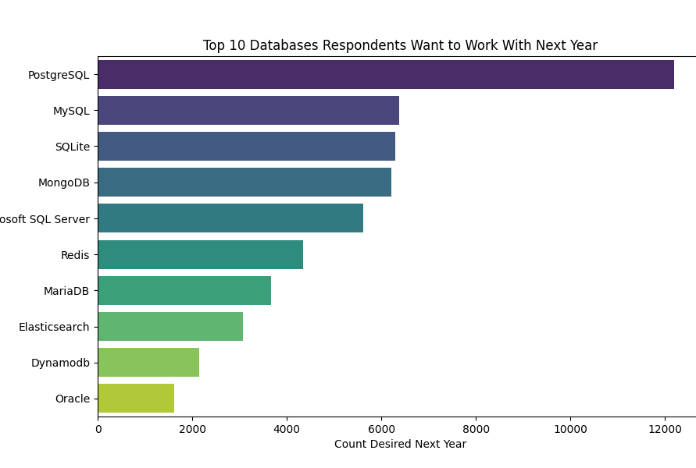
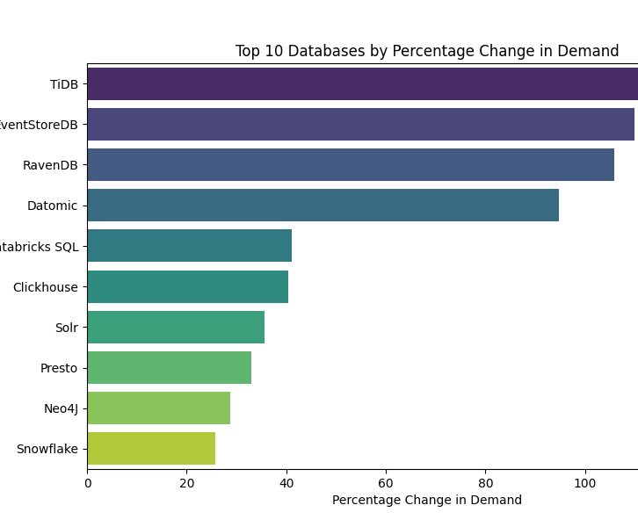
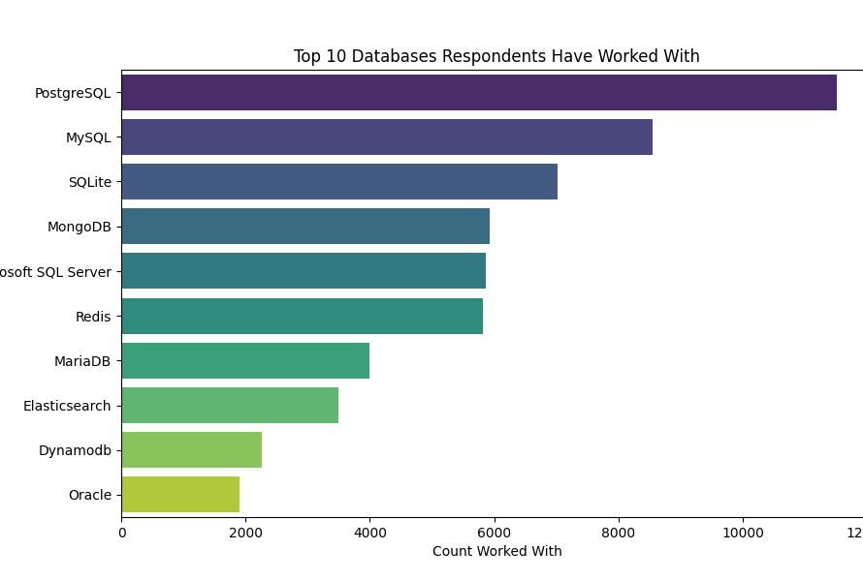

Slide 8
Key Findings: Database Trends
Interpretation of Results
Database: The databases listed in order of the highest to the lowest percentage change in demand.
Count Worked With: The number of respondents who have worked with each database.
Count Desired Next Year: The number of respondents who want to work with each database in the next year.
Demand Change: The percentage change in demand for each database, calculated as: $$\text{Demand Change} = \left(\frac{\text{Count Desired Next Year} - \text{Count Worked With}}{\text{Count Worked With}}\right) \times 100$$

Slide 9


Key Findings: Database Trends
Relational Databases Dominate
Rise of NoSQL Databases
MySQL, PostgreSQL, and SQLite are the most widely used database technologies, reflecting their continued popularity and adoption.
NoSQL databases, such as MongoDB, are gaining traction and are expected to see increased demand in the future.
The analysis highlights the coexistence of traditional relational databases and the growing adoption of NoSQL technologies, as developers and organizations seek to address evolving data management requirements.

Slide 10


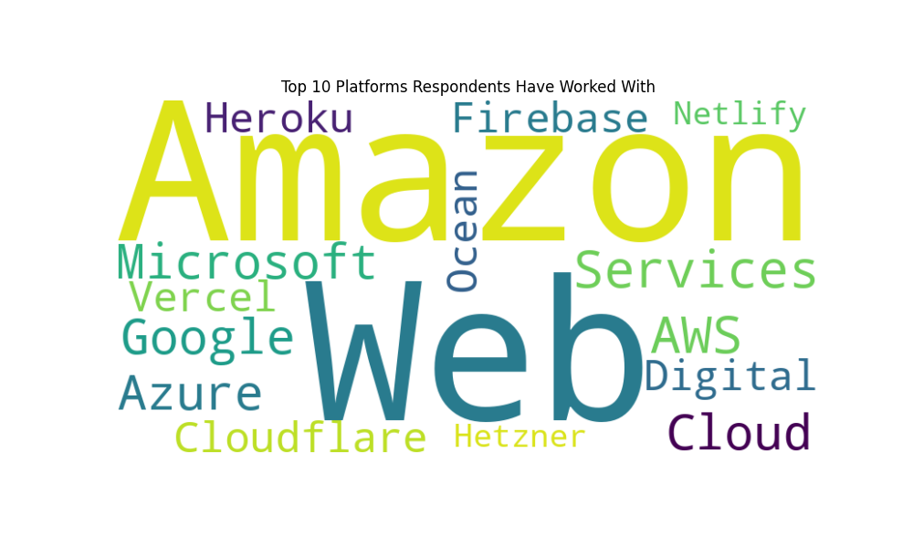
Platforms Respondents Have Worked With

Slide 11
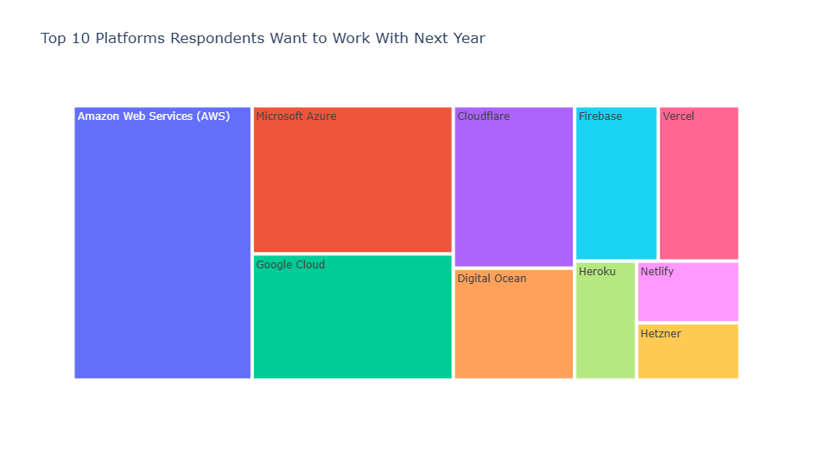
Platforms Respondents Want to Work With Next Year

Slide 12



Key Findings: Platform Trends
Most Popular IDEs
Stable Preferences
Emerging Tool Interest
Visual Studio Code, IntelliJ IDEA, and PyCharm are the most widely used Integrated Development Environments (IDEs) among developers.
Preferences for IDEs are expected to remain relatively stable, with only minor shifts towards emerging tools.
While the top IDEs will maintain their prominence, there is a potential increase in interest for newer or specialized IDEs to cater to evolving development trends and technologies.
The insights into IDE usage trends can help organizations and developers make informed decisions, optimize technology investments, and align their skill sets with the evolving software development landscape.

Slide 13
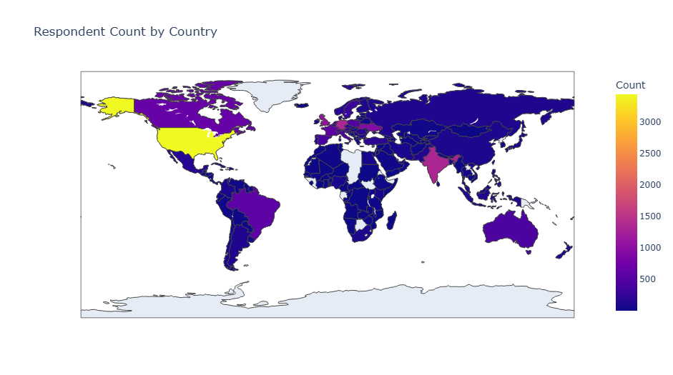

Slide 14
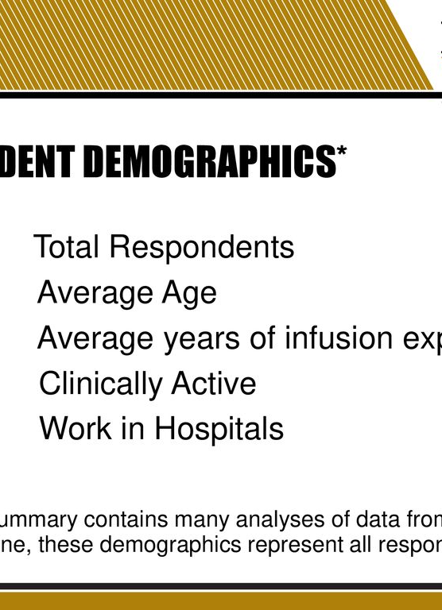
Demographic Analysis
The analysis of respondent demographics reveals a diverse population of developers, with a significant concentration in the 25-34 and 35-44 age groups, indicating a young to mid-career professional community. The respondent pool is also predominantly composed of individuals with higher education, particularly at the undergraduate and graduate levels, reflecting the educational attainment of the broader developer community. The geographical distribution of respondents showcases a global reach, with the majority coming from the United States and India.

Slide 15
Key Findings: Demographics
Young to Mid-Career Professionals
The majority of respondents are in the 25-34 and 35-44 age groups, indicating a predominance of young to mid-career professionals.
Higher Education Background
Most respondents hold a bachelor's or master's degree, suggesting a highly educated developer community.
Prominent Geographies
The largest number of respondents are from the United States and India, indicating these as significant hubs for the surveyed developer community.

Slide 16
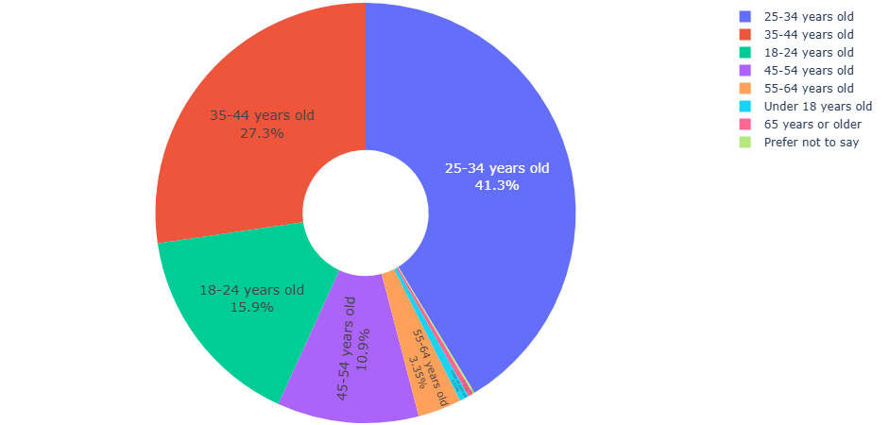

Slide 17
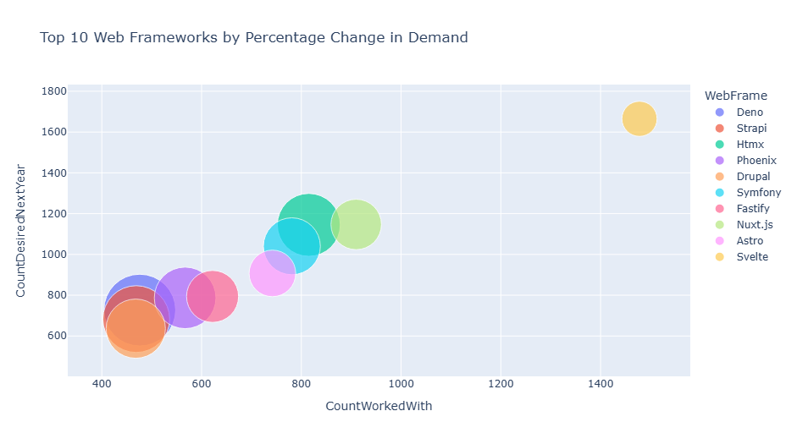

Slide 18
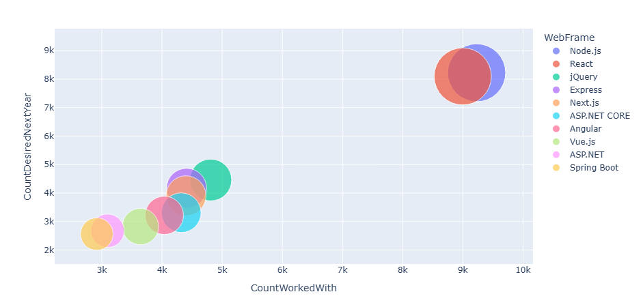

Slide 19
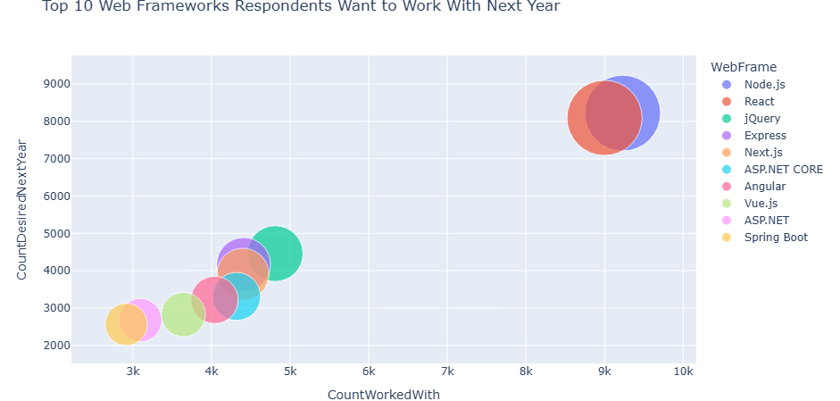

Slide 20
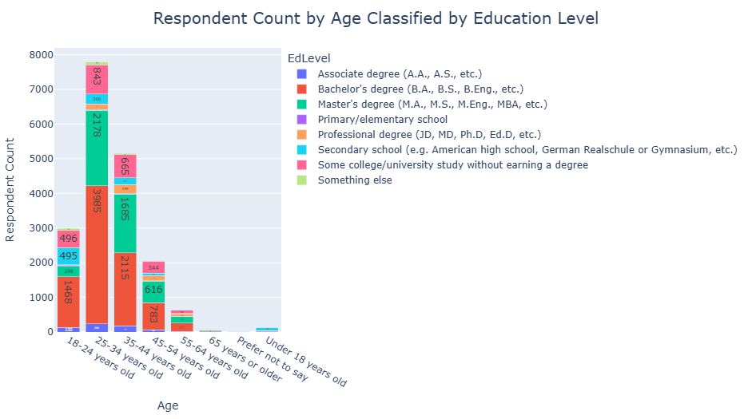

Slide 21
Overall Interpretation
The age distribution shows a concentration of respondents in the 25-34 and 35-44 age groups, indicating that the majority of participants are early to mid-career professionals. This reflects the active involvement of individuals who are likely in their prime working years in the tech industry. Younger participants (18-24 years old) also form a significant portion, suggesting a continuous influx of new talent entering the field. The presence of older age groups highlights the sustained contribution of experienced professionals.
These insights can help understand the demographic trends within the developer community and inform strategies for engaging different age groups in tech-related initiatives.

Slide 22
Conclusion
Dynamic Technology Landscape
Adoption of Cloud-Native Practices
Skill Development Opportunities
The analysis reveals a rapidly evolving technology landscape, with professionals embracing new tools and platforms to enhance their skills and meet industry demands.
The increasing popularity of cloud platforms, containerization, and modern programming languages indicates a clear trend towards cloud-native development practices.
Insights from the analysis can guide individuals and organizations in their skill development strategies, ensuring they stay competitive in the changing industry.
Informed Technology Decisions
Adaptability and Continuous Learning
Understanding the emerging trends in programming languages, databases, and platforms can help organizations make more informed decisions about their technology stack and workforce planning.
The evolving technology landscape requires both individuals and organizations to continuously update their skills and adapt to new tools and platforms to stay relevant.

Slide 23
Conclusion
The analysis of the survey data reveals insightful trends in programming languages, databases, platforms, and demographics within the developer community.
Key Observations:
Programming Languages: While established languages like JavaScript and Python remain popular, languages such as Rust, Go, and TypeScript are experiencing significant growth in demand, indicating a shift towards newer technologies.
Databases: PostgreSQL and MongoDB are the most sought-after databases, reflecting the increasing adoption of cloud-based and NoSQL solutions.
Platforms: AWS, Docker, and Kubernetes dominate the platform landscape, highlighting the importance of cloud computing and containerization.
Web Frameworks: React.js, Node.js, and Vue.js are highly desired web frameworks, demonstrating the popularity of JavaScript-based technologies.
Demographics: The majority of respondents are young to mid-career professionals with Bachelor's or Master's degrees, predominantly located in the United States and India.
Overall:
The data suggests a dynamic and evolving technology landscape. Professionals are embracing new technologies and tools to enhance their skill sets and meet the changing demands of the industry. The popularity of cloud platforms, containerization, and modern programming languages indicates a clear trend towards cloud-native development practices. These insights can help individuals and organizations make informed decisions about skill development, technology adoption, and workforce planning.

Slide 24







Conclusion Summary
Growth in Demand for Newer Languages
Increasing Adoption of NoSQL Databases
Rising Popularity of Cloud-Native Platforms
Emergence of Modern Web Frameworks

